Slide 1
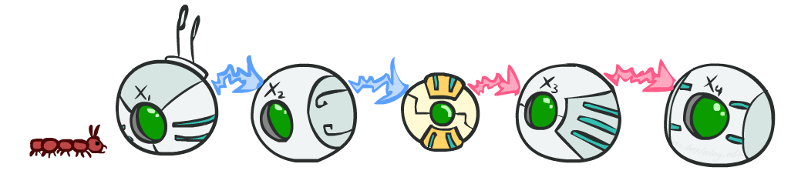
CS 188: Artificial Intelligence
Markov Models
Instructors: Dan Klein and Pieter Abbeel --- University of California, Berkeley
[These slides were created by Dan Klein and Pieter Abbeel for CS188 Intro to AI at UC Berkeley. All CS188 materials are available at http://ai.berkeley.edu.]
Notes:
Please retain proper attribution, including the reference to ai.berkeley.edu. Thanks!

Slide 2
Reasoning over Time or Space
Often, we want to reason about a sequence of observations
Speech recognition
Robot localization
User attention
Medical monitoring
Need to introduce time (or space) into our models

Slide 3


Markov Models
Value of X at a given time is called the state
Parameters: called transition probabilities or dynamics, specify how the state evolves over time (also, initial state probabilities)
Stationarity assumption: transition probabilities the same at all times
Same as MDP transition model, but no choice of action
X₁
X₂
X₃
X₄

Slide 4
Joint Distribution of a Markov Model
X₁
X₂
X₃
X₄
Joint distribution:
More generally:
Questions to be resolved:
Does this indeed define a joint distribution?
Can every joint distribution be factored this way, or are we making some assumptions about the joint distribution by using this factorization?

Slide 5
Chain Rule and Markov Models
X₁
X₂
X₃
X₄
From the chain rule, every joint distribution over can be written as:
Assuming that
and
results in the expression posited on the previous slide:

Slide 6
Chain Rule and Markov Models
X₁
X₂
X₃
X₄
From the chain rule, every joint distribution over can be written as:
Assuming that for all t:
gives us the expression posited on the earlier slide:

Slide 7
Markov Models Recap
Explicit assumption for all t :
Consequence, joint distribution can be written as:
Additional explicit assumption: is the same for all t

Slide 8
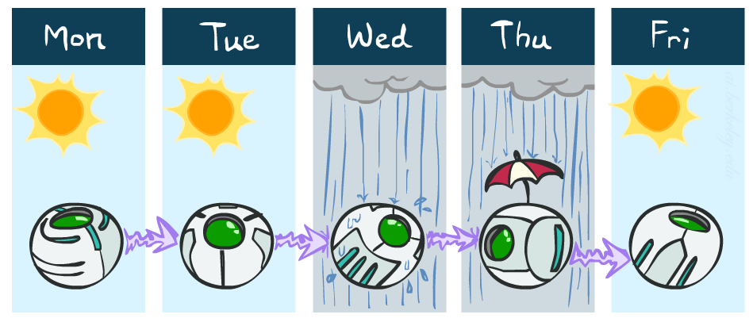
Example Markov Chain: Weather
States: X = {rain, sun}
Initial distribution: 1.0 sun
CPT P(X_{t} | X_{t-1}):
Two new ways of representing the same CPT
X_{t-1} | X_{t} | P(X_{t}|X_{t-1})
sun | sun | 0.9
sun | rain | 0.1
rain | sun | 0.3
rain | rain | 0.7
0.9
0.3
0.9
rain
sun
sun
sun
0.1
0.3
rain
rain
0.7
0.7
0.1

Slide 9
Example Markov Chain: Weather
0.9
Initial distribution: 1.0 sun
What is the probability distribution after one step?
0.3
rain
sun
0.7
0.1

Slide 10
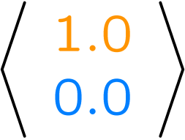
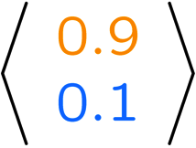
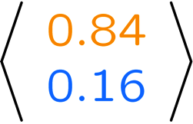
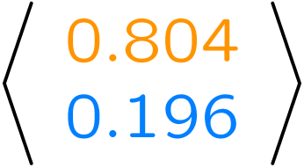
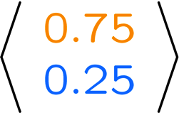
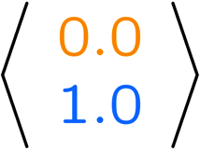
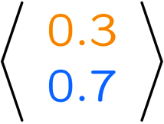
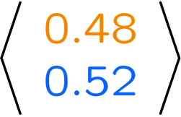
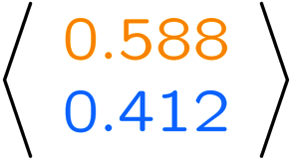
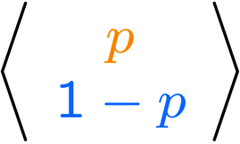
Example Run of Mini-Forward Algorithm
From initial observation of sun
From initial observation of rain
From yet another initial distribution P(X₁):
P(X₁)
P(X₂)
P(X₃)
P(X₄)
P(X∞)
P(X₁)
P(X₂)
P(X₃)
P(X₄)
P(X∞)
…
P(X₁)
P(X∞)
[Demo: L13D1,2,3]

Slide 11

Stationary Distributions
For most chains:
Influence of the initial distribution gets less and less over time.
The distribution we end up in is independent of the initial distribution
Stationary distribution:
The distribution we end up with is called the stationary distribution of the chain
It satisfies

Slide 12
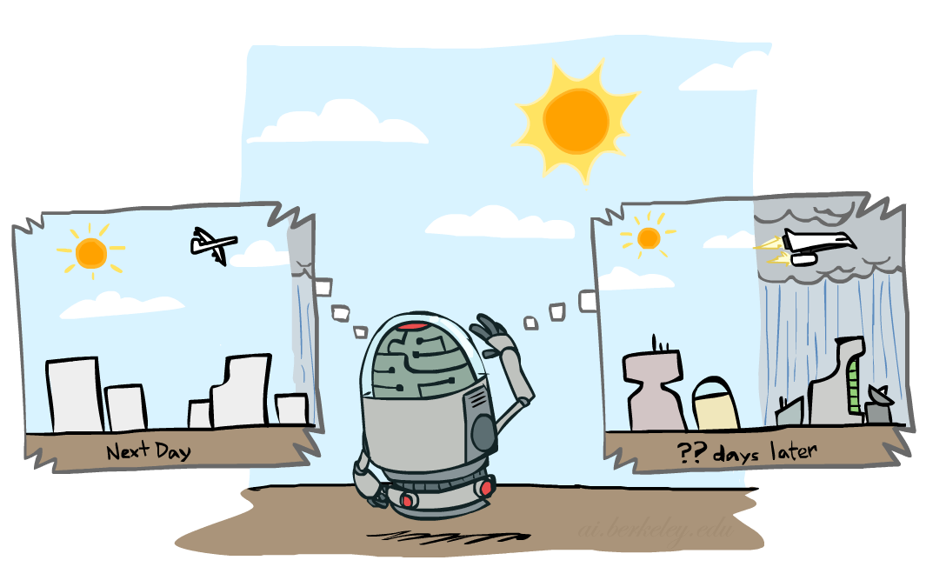
Example: Stationary Distributions
Question: What’s P(X) at time t = infinity?
X₁
X₂
X₃
X₄
X_{t-1} | X_{t} | P(X_{t}|X_{t-1})
sun | sun | 0.9
sun | rain | 0.1
rain | sun | 0.3
rain | rain | 0.7
Also:

Slide 13


Random Variable X in {a, b, c}
Transition matrix: $\left[\begin{aligned}\frac{2}{5} \frac{2}{5} \frac{1}{5} \\ \\ \frac{1}{5} \frac{3}{5} \frac{1}{5} \\ \\ \frac{1}{5} \frac{2}{5} \frac{2}{5}\end{aligned}\right]$

Slide 14
P∞(a)= P(a|a)X P∞(a)+ P(a|b)X P∞(b)+ P(a|c)X P∞(c)
=> P∞(a)=2/5 P∞(a)+1/5 P∞(b)+1/5 P∞(c)
=>5 P∞(a)=2 P∞(a)+ P∞(b)+ P∞(c)
=>3 P∞(a)- P∞(b)- P∞(c)=0 -------- (i)
P∞(b)= P(b|a)X P∞(a)+ P(b|b)X P∞(b)+ P(b|c)X P∞(c)
=> P∞(b)=2/5 P∞(a)+3/5 P∞(b)+2/5 P∞(c)
=>5 P∞(b)= 2P∞(a)+ 3P∞(b)+ 2P∞(c)
=>2P∞(a)- 2P∞(b)+ 2P∞(c)=0
=>P∞(a)- P∞(b)+ P∞(c)=0-------- (ii)

Slide 15
3 P∞(a)- P∞(b)- P∞(c)=0 -------- (i)
P∞(a)- P∞(b)+ P∞(c)=0-------- (ii)
P∞(a)+ P∞(b)+ P∞(c)=1--------(iii)
P∞(a)=1/4, P∞(b)=1/2, P∞(c)=1/4

